Slide 1
Week 4: decision tree
IST 565 Data Mining

Slide 2
Illustrating Classification Task
Two steps
Notes:
Automated Classification is a two step process. The first step is induction. In this process we use a learning algorithm to learn or train a model based on a set of training data. The second step is deduction, when we apply the learned model to test data, in which the decisions are unknown.

Slide 3
Classification Techniques
Many classification algorithms have been developed to date.
This class will introduce the details of several most popular algorithms
Decision Tree
Bayesian method (naïve Bayes)
Instance-based learning (k-Nearest Neighbor)
Support Vector Machines (SVMs)
In this week, we illustrate classification tasks using Decision Tree methods
Notes:
These algorithms represent different mathematical ideas.
We will also introduce how to pick and choose algorithms based on the characteristics of your data

Slide 4
Decision Tree Classification Task
Decision Tree
Notes:
A decision tree classification method would learn a decision tree as the model for prediction. What does a decision tree look like?

Slide 5
An Example of Decision Tree
Problem: to label each person as to whether they will cheat IRS
categorical
categorical
continuous
class
Root node
Splitting Attributes
Edge: test attribute condition
Refund
Internal node
Yes
No
NO
MarSt
Single, Divorced
Married
TaxInc
NO
Leaf node with class label
< 80K
> 80K
NO
YES
Training Data
Model: Decision Tree
Notes:
An upside down tree has some nodes and edges. Two kinds of nodes, the leaf nodes and internal node. A special node at the top is the root node. Every internal node is an attribute, and the whole data set will be split based on the values of this attribute. The edges are conditions.
For example the root node “refund” can take yes and no values. This tree learned from the training data that

Slide 6
Another Example of Decision Tree
categorical
categorical
continuous
class
MarSt
Single, Divorced
Married
NO
Refund
Yes
No
NO
TaxInc
< 80K
> 80K
NO
YES
There could be more than one tree that fits the same data!

Slide 7
exercise: manually build a DT
Task: Open up the Titanic data, observe the patterns, and manually build a decision tree that includes at least two internal nodes. Here is an example of the simplest tree with only one internal node.
Note the goal of this exercise is to check if you understand the concept of a decision tree model. No need to build super-sophisticated trees. Also, don’t worry about its actual performance either at this time.
Sex
male
Female
NO
YES

Slide 8
How to find the best decision tree?
Too many candidate trees
Manual construction takes too long
Need some machine intelligence to help

Slide 9
Decision Tree Induction
Many Algorithms:
Hunt’s Algorithm (one of the earliest)
CART
ID3, C4.5
SLIQ,SPRINT
C4.5 is introduced in this class

Slide 10
Tree Induction
Key questions to build a decision tree model
Which attribute to pick as internal node?
How to split the data set at a node?
Notes:
Which attribute to choose? How to split? For easier understanding, first talk about how to split, then about choose attributes.

Slide 11
How to split data at a node?
How many branches?
Splitting can be
2-way split
multi-way split
What are the splitting values?
Splitting conditions depend on attribute type
Nominal/categorical
Ordinal
Continuous
Notes:
Splitting means the attribute has to be categorical

Slide 12
Splitting Based on Categorical Attributes
Multi-way split: Use as many partitions as distinct values.
Binary split: Divides values into two subsets. Need to find optimal partitioning.
CarType
Family
Luxury
Sports
CarType
CarType
{Sports, Luxury}
OR
{Family, Luxury}
{Family}
{Sports}

Slide 13
Splitting Based on Continuous Attributes
Different ways of handling
Discretization to form an ordinal categorical attribute
E.g. age: 1 1 6 7 8 9 9 9 10 10 11 11 12 13 14 15 17 18
equal interval: one bin for every six year [0-6][7-12][13-18]
1 1 6 • 7 8 9 9 9 10 10 11 11 12 • 13 14 15 17 18
equal frequency: one bin for every six numbers (could have ties)
1 1 6 7 8 • 9 9 9 10 10 11 11 • 12 13 14 15 17 18
Customized discretization
Notes:
Using age an example, equal interval bucketing, frequency-based

Slide 14
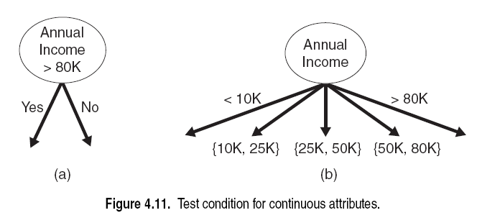
Splitting Based on Continuous Attributes

Slide 15
Determine the Best Attribute for Splitting
Information Gain (IG)
A statistical measure that measures how well a given attribute separates the training examples according to their target classification. (Mitchell, 1990)

Slide 16
Determine the Best Attribute for Splitting
Entropy
To measure the impurity of a data set
Given a collection S which contains positive (+) and negative (-) examples, p_{i} is the probability that an example belongs to Class i
Entropy(S) = - p₊log₂p₊ - p₋log₂p₋
What is the entropy for each of the following collections?
＋＋－－
＋＋＋＋
－－－－

Slide 17
Determine the Best Attribute for Splitting
Entropy
A measure that characterizes the impurity of a collection of examples
Given a collection S which contains positive (+) and negative (-) examples, p_{i} is the probability that an example belongs to Class i
Entropy(S) = - p₊log₂p₊ - p₋log₂p₋
A collection of half positive examples and half negative examples
Entropy(S) = 1
A collection of all positive examples or all negative examples
Entropy(S) = 0
entropy
1
P₊

Slide 18
Information Gain: how much improvement toward purity?
categorical
categorical
continuous
class
MarSt
Single, Divorced
Married
NO:4
NO:3;Yes:3
The expected reduction in entropy caused by knowing the value of attribute A

Slide 19
Information Gain: how much improvement toward purity?
categorical
categorical
continuous
class
MarSt
Single, Divorced
Married
NO:4
NO:3;Yes:3
Entropy(S)=-0.7*log2(0.7)-0.3*log2(0.3)=0.88
Entropy(S1)=0
Entropy(S2)=1
IG=0.88-(0.4*0 + 0.6*1) = 0.28
Repeat this calculation to find the attribute that provides the highest IG

Slide 20
Which attribute should be the first node?
Calculate the information gain (IG) for each attribute, choose the one with the highest IG.

Slide 21
What’s the next step?
Repeat the IG calculation for every subset generated from the last step
Until all nodes are “pure” with all positive examples, or all negative examples. These are all leaf nodes.

Slide 22
Exercise: calculate Info Gain
Let’s start with “age”, , see if the entropy gets smaller after using age to split the data.
Step 1: calculate the entropy of the entire training data set S, which contains 9 positive examples and 5 negative examples.

Slide 23
Exercise: calculate Info Gain
Let’s start with “age”, , see if the entropy gets smaller after using age to split the data.
Step 1: calculate the entropy of the entire training data set S, which contains 9 positive examples and 5 negative examples.

Slide 24
Exercise: calculate Info Gain
Step 2: count the numbers of positive examples (column p_{i}) and negative examples (column n_{i}) in each subset, and then calculate the entropy for each subset, I(p_{i}, n_{i}).
For example, for the “<=30” subset S₁,
Similarly,
Entropy(S₂) =0;
Entropy(S₃) = Entropy(S₁)=0.971
Class P: buys_computer = “yes”
Class N: buys_computer = “no”

Slide 25
Exercise: calculate Info Gain
Step 3: calculate the weighted average entropy after using age to split the data into three subsets “<=30”, “31..40”, and “>40”.
Class P: buys_computer = “yes”
Class N: buys_computer = “no”

Slide 26
Exercise: calculate Info Gain
Step 4: calculate the information gain of using age to split the data into three subsets “<=30”, “31..40”, and “>40”.
Class P: buys_computer = “yes”
Class N: buys_computer = “no”

Slide 27
Which attribute should be the first node?
Step 5: repeat the process for each attribute, and then pick the attribute with highest IG as the first node.
The DT now hass one leaf node
And two subsets that needs
To be further split.
(9,5)
age
<=30
>40
31..40
?
?
Yes
(2,3)
(4,0)
(3,2)

Slide 28
What’s the next step?
Repeat the prior steps for the subsets (2,3) and (3,2).
For subset (2,3), calculate IG for each attribute, pick the attribute with highest IG to replace the question mark.
Do the same thing to the subset (3,2)
Until all nodes are “pure” with all positive examples, or all negative examples.
(9,5)
age
<=30
>40
31..40
?
?
Yes
(2,3)
(4,0)
(3,2)

Slide 29
Gain Ratio
Impurity measures tend to favor attributes that have a large number of distinct values (textbook pp. 163)
E.g. the “ticket” attribute in the Titanic data set means the ticket number. Assuming every passenger has unique ticket number, the ticket attribute has many distinct values, and impurity measures like IG favors such attributes.
ticket
(1,0)
(0,1)

Slide 30
Gain Ratio
What to do?
Use domain knowledge: ticket number has nothing to do with survival chance?
Use Gain Ratio, which is IG divided by “split info”
“Split info” is a penalty to a large number of splits
In J48, the information gain measure has taken steps to avoid choosing the “ticket” types of attributes.

Slide 31
Converting Decision Tree to Decision Rules
refund?
yes
no
No cheat
Marital Status?
married
Taxable Income?
No cheat
<80K
>=80K
Tree can be displayed as a set of rules:
No cheat
Cheat
If refund = yes then then “no cheat”
else if martital_status = “married” then “no cheat”
else if taxable_income < 80K then “no cheat”
else “cheat”

Slide 32
Decision Tree Classification Task
Decision Tree

Slide 33
Apply Model to Test Data
Test Data
Refund
Yes
No
NO
MarSt
Single, Divorced
Married
TaxInc
NO
< 80K
> 80K
NO
YES

Slide 34
Apply Model to Test Data
Test Data
Refund
Yes
No
NO
MarSt
Single, Divorced
Married
TaxInc
NO
< 80K
> 80K
NO
YES

Slide 35
Apply Model to Test Data
Test Data
Refund
Yes
No
NO
MarSt
Single, Divorced
Married
TaxInc
NO
< 80K
> 80K
NO
YES

Slide 36
Apply Model to Test Data
Test Data
Refund
Yes
No
NO
MarSt
Single, Divorced
Married
TaxInc
NO
< 80K
> 80K
NO
YES

Slide 37
Apply Model to Test Data
Test Data
Refund
Yes
No
NO
MarSt
Single, Divorced
Married
Assign Cheat to “No”
TaxInc
NO
< 80K
> 80K
NO
YES

Slide 38
Characteristics of decision tree induction
DT is a nonparametric algorithm, meaning it does not require any prior assumptions regarding the type of probability distributions satisfied by the class and other attributes
Linear classification algorithms are parametric algorithms because they assume the decision boundary is linear, such as a line in 2-dimensional space
“decision boundary” means the border between two neighboring regions of different classes.

Slide 39
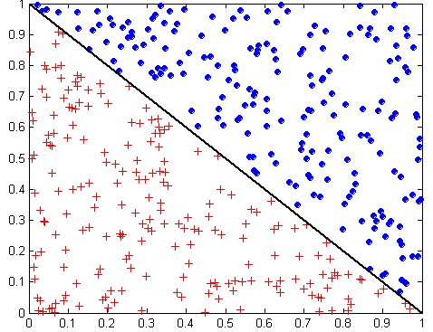
There is no silver bullet…
nonlinear
linear
Notes:
Re-construct DT model for the left graph:
X <0.43
Y<0.48 blue
Y>=0.48 red
X > 0.43
Y<0.32 red
Y>=0.32 blue
Decision boundary in the right graph: x+y=1
Can you find a line to separate red from blue in the left graph?
Can you build a DT to separate red from blue in the right graph?

Slide 40
Model Overfitting
Decision trees have the particular problem of overfitting
There may not be enough examples to fully represent all possible cases that may arise in the future
If decision tree is fully developed, it may be too detailed a fit to the training data and lead to more errors on the test data
E.g. assume we are looking for patterns of buyers for a certain product. In the training data set, no women purchased a product, the DT algorithm may learn a pattern that “if women, no purchase”. But this training data set included very few women, and actually there were women who bought this product. In such case, the DT model overfits the training data and lost precision in future prediction.
Occam’s razor (preference of small trees)

Slide 41
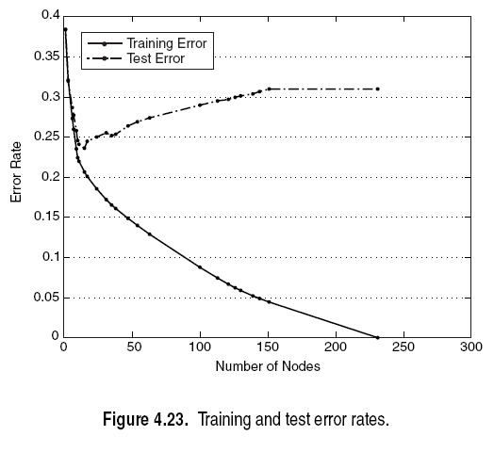
Model Overfitting
Generally speaking, complex models are more likely to overfit than simple models
For decision tree, #nodes indicates model complexity.
In this figure, the higher the #nodes, the lower the training error, and the higher the test error, meaning the increasingly complex models are increasingly overfitting.

Slide 42
Overfitting and Tree Pruning
Two approaches to avoid overfitting
Prepruning: Halt tree construction early—do not split a node if information gain falls below a threshold
Difficult to choose an appropriate threshold
Postpruning: Remove branches from a “fully grown” tree—get a sequence of progressively pruned trees
Use a set of data different from the training data to decide which is the “best pruned tree”

Slide 43
Summary of Decision Trees
Strengths of decision trees are that they:
Fast in prediction
Interpretable patterns
Robust to noise
Weaknesses of decision trees are that they:
Tend to overfit (pruning helps)
Are error prone with too many classes
Are computationally expensive in training (compared to the low cost in prediction)

Slide 44
exercise: info gain and decision tree in Weka J48
Load the titanic training data into Weka
Run information gain feature ranking
Observe the top ranked features
Observe the built decision tree

